Slide 1

A QUALITATIVE COMPARISON OF NS3 AND SELECT NETWORK SIMULATORS:
OMNET++, CISCO PACKET TRACER, AND GNS3
James Kielson S. Cipriaso
Gebromel A. Yparraguirre Jr

Slide 2

PROBLEM STATEMENT
Evaluation of NS3, OMNeT++, Cisco Packet Tracer, and GNS3.
Focused metrics: ease of use, capabilities, and use cases.
Goal: Assist in tool selection for network simulation needs.

Slide 3
OBJECTIVES
Primary Objective:
Provide a comparative evaluation of NS3, OMNeT++, Cisco Packet Tracer, and GNS3.
Specific Goals:
Identify strengths and limitations of each simulator based on ease of use, capabilities, and typical use cases.
Conduct hands-on testing using standardized scenarios for practical insights.

Slide 4
LITERATURE REVIEW SUMMARY
Highlighted Metrics:
Scalability: NS3 and OMNeT++ excel in handling large and complex networks.
Simulation Speed: OPNET and QualNet offer superior performance for high-demand scenarios.
Resource Efficiency: GloMoSiM and JiST/SWANS are memory efficient but limited in scalability.
User-Friendliness: Cisco Packet Tracer and OMNeT++ stand out for ease of use.
Tool-Specific Findings:
NS3: Flexible, packet-level accuracy, ideal for academic research.
OMNeT++: Modular, GUI-supported, suitable for IoT and vehicular networks.
Cisco Packet Tracer: Best for education and beginner networking scenarios.
GNS3: Excellent for real-world emulation but resource-intensive.

Slide 5
NETWORK SIMULATION TOOLS
NS-3:
Packet-level simulator (C++/Python)
+ Flexible, scalable. - High learning curve
OMNeT++:
Modular with GUI support
+ Extensible, great for IoT. - Limited scalability
Cisco Packet Tracer:
Educational, drag-and-drop interface
+ Easy to use. - Not fully realistic
GNS3:
Real-device emulation with Cisco IOS
+ Professional-grade. - Resource-heavy

Slide 6
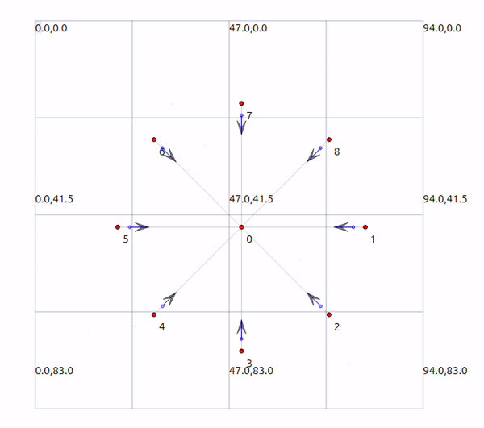
NETWORK SIMULATION TOOLS: NS3
Ease of Use
Extensive documentation and online tutorials available.
Challenging for beginners due to programming requirements.
Flexible and highly customizable for experienced users.
Requires Linux OS and C++ programming expertise.
Tool Abilities
Network Tracing: Visualized with NetAnim (e.g., star topology simulation).
Traffic Analysis: Generates .pcap files for detailed packet analysis.
Supports custom module development for specific scenarios.
Use Cases
Ideal for academic research and custom network scenarios.
Open-source structure fosters collaboration and innovation in the networking community.

Slide 7
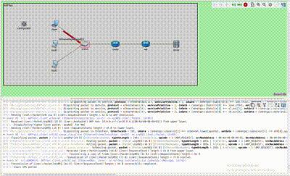
NETWORK SIMULATION TOOLS: OMNET++
Ease of Use
Built-in IDE provides tools like syntax highlighting, code completion, and project management.
Supports multiple operating systems (Windows, Linux, MacOS).
Comprehensive documentation and tutorials available.
Real-time simulation visualization improves usability over NS3.
Tool Abilities
Graphical interface eliminates the need for external libraries (e.g., NetAnim).
Enables real-time traffic visualization alongside simulation graphics.
Allows detailed configuration through .ned and omnetpp.ini files for custom network scenarios.
Produces .pcap, .vec, and .sca files for comprehensive analysis and plotting.
Use Cases
Suitable for academic and professional network development.
Beginner-friendly visual interface complements advanced C++ scripting.
Palette of network modules enables diverse simulations (e.g., ARP test networks).

Slide 8
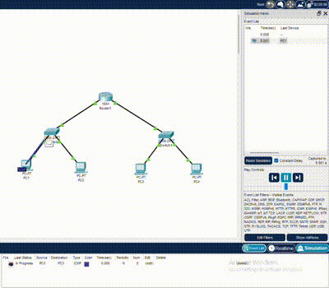
NETWORK SIMULATION TOOLS: CISCO PACKET TRACER
Ease of Use
Gentle learning curve, ideal for students and educators.
Built-in modules (routers, switches, PCs) with drag-and-drop interface.
Customizable device features:
Physical Configurations: Add peripherals like network cards, headphones.
Software Configurations: Set IP addresses, test web browsers, terminals.
Tool Abilities
Device-centric configuration for networks, rather than scripting.
Real-time simulation of packet traversal using Protocol Data Units (PDUs).
Modules emulate real-world devices, enhancing realism.
Limited to high-level network scenarios.
Use Cases
Designed for teaching basic networking concepts.
Excellent for small-scale network projects and hands-on learning.
Not suitable for advanced, low-level simulations like NS3 or OMNeT++.

Slide 9
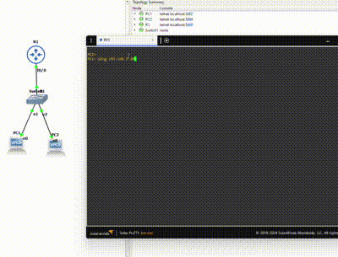
NETWORK SIMULATION TOOLS: GNS3
Ease of Use
Drag-and-drop interface similar to Cisco Packet Tracer.
Modular design allows user-added IOS images for customization.
Configuration performed via device CLI; results are not auto-generated into files.
Suitable for teaching modularity in networking.
Tool Abilities
Device emulation using IOS images (e.g., Cisco 7200 router).
Realistic virtualization requiring system resources (RAM, adapters).
Configurations depend on vendor IOS image capabilities.
Enables concurrent work on multiple virtual devices.
Use Cases
Ideal for networking education with legitimate software in a controlled environment.
Useful in professional work for testing advanced topologies and device configurations.
Provides sophisticated simulation features with high realism.

Slide 10
DISCUSSION OF FINDINGS
Ease of Use
Cisco Packet Tracer:
Easiest tool to use, ideal for educational purposes.
Features drag-and-drop functionality, customizable modules, and an intuitive interface.
Widely used by students to learn networking basics like protocols, connections, and routing.
Tool Abilities
OMNeT++:
Feature-rich, modular, and flexible.
Includes a graphical simulation interface, surpassing NS3 in usability.
Best suited for simulating diverse scenarios, modeling protocols, and scaling simulations.

Slide 11
DISCUSSION OF FINDINGS
Use Cases
NS3:
Most versatile for professional research and analysis.
Focuses on programming network scenarios with near-unlimited possibilities.
Supported by a robust developer community, ensuring continued innovation.

Slide 12
AI-DRIVEN INSIGHTS
Ease of Use
Cisco Packet Tracer: Most accessible tool.
Drag-and-drop interface, beginner-friendly.
Supported by Cisco Networking Academy tutorials.
Best for introductory learning and teaching.
Tool Abilities
NS-3: Most powerful for complex scenarios.
Feature-rich for advanced simulations and protocol development.
Ideal for academic and research use.

Slide 13
AI-DRIVEN INSIGHTS
Use Cases
GNS3: Best for professional lab testing and real-world emulation.
Supports virtual and physical devices.
Compatible with Cisco IOS images for enterprise-grade setups.
Preferred for network design, troubleshooting, and certifications.

Slide 14
CONCLUSION
NS3 is best suited for the research and analysis of diverse network scenarios, offering a highly customizable and comprehensive low-level simulation environment.
OMNeT++ emerges as the optimal choice for network development, thanks to its extensive module library and user-friendly graphical simulation interface.
Cisco Packet Tracer is recognized as the ideal tool for network learning and light simulations, providing an accessible platform for introductory and educational purposes.
This diversity in network simulation tools ensures accessibility to individuals at various skill levels, fostering a more comprehensive understanding of computer networking across educational and professional domains.

Slide 15
THANK YOU

Slide 16
REFERENCES
A. T, “A Comparative Study of Various Network Simulation Tools,” Aug. 2016. Available: https://www.ijcset.com/docs/IJCSET16-07-08-032.pdf. [Accessed: Nov. 13, 2024]
A. Ur, R. Khan, S. Bilal, and M. Othman, “A Performance Comparison of Network Simulators for Wireless Networks,” Jul. 2013. Available: https://arxiv.org/pdf/1307.4129
M. Kabir, S. Islam, M. Hossain, and S. Hossain, “Detail comparison of network simulators,” 2014. doi: https://doi.org/10.13140/RG.2.1.3040.9128
E. Weingartner, vom Lehn, and K. Wehrle, “A performance comparison of recent network simulators,” 2009, pp. 1–5. doi: https://doi.org/10.1109/ICC.2009.5198657
V. V and S. Lakshmi, “A case study of various wireless network simulation tools,” Aug. 2018, doi: https://doi.org/10.13140/RG.2.2.32223.30885
“NS3 Manual Release NS3.43 NS3 project,” 2024. Available: https://www.nsnam.org/docs/release/3.43/manual/NS3-manual.pdf. [Accessed: Nov. 14, 2024]
L. Campanile, M. Gribaudo, M. Iacono, F. Marulli, and M. Mastroianni, “Computer network simulation with NS3: A systematic literature review,” Electronics, vol. 9, Art. no. 2, 2020, doi: https://doi.org/10.3390/electronics9020272. Available: https://www.mdpi.com/2079-9292/9/2/272
A. Varga and R. Hornig, “AN OVERVIEW OF THE OMNeT++ SIMULATION ENVIRONMENT,” 2008. Available: https://doc.omnetpp.org/publications/1416290.pdf
S. Bachmeier, B. Jaeger, and K. Holzinger, “Network Simulation with OMNet++,” Nov. 2020, doi: https://doi.org/10.2313/NET-2020-11-1_08. Available: https://www.net.in.tum.de/fileadmin/TUM/NET/NET-2020-11-1/NET-2020-11-1_08.pdf
B. Lantz and B. Heller, “A network in a laptop: Rapid prototyping for software-defined networks,” in Proceedings of the 9th ACM SIGCOMM Workshop on Hot Topics in Networks, Oct. 2010, p. 19. doi: https://doi.org/10.1145/1868447.1868466
Z. Trabelsi and H. Saleous, “Exploring the opportunities of cisco packet tracer for hands-on security courses on firewalls,” 2019, pp. 411–418. doi: https://doi.org/10.1109/EDUCON.2019.8725112
J. Allison, “Simulation-based learning via cisco packet tracer to enhance the teaching of computer networks,” Dublin, Ireland: Association for Computing Machinery, 2022, pp. 68–74. doi: https://doi.org/10.1145/3502718.3524739. Available: https://doi.org/10.1145/3502718.3524739
GNS3, “Getting Started with GNS3 | GNS3 Documentation,” mother.github.io. Available: https://docs.gns3.com/do

